Slide 1
Lecture 8
Chapter 7
Ontology Engineering
Grigoris Antoniou
Frank van Harmelen
Chapter 7
A Semantic Web Primer

Slide 2
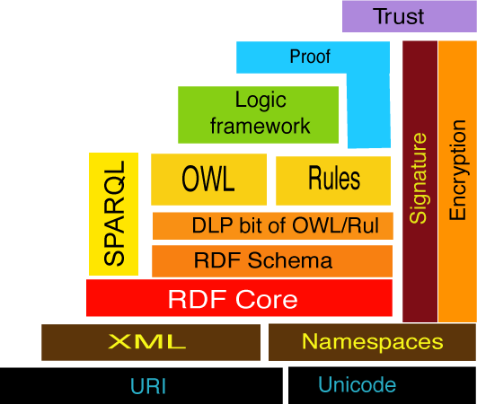
As you know in Specific Semantic Web Layer, Logic is on the top of OWL and SPARQL is used for query of RDF and OWL documents:
Chapter 1
A Semantic Web Primer

Slide 3
Ontology Engineering
Introduction of Ontology Engineering
Constructing Ontologies Manually
Reusing Existing Ontologies
Semiautomatic Ontology Acquisition
Ontology Mapping
Architecture
Chapter 7
A Semantic Web Primer

Slide 4
  Which languages and tools should be used in which circumstances, and in which order?
  What about issues of quality control and resource management?
Many of these questions for the Semantic Web have been studied in other contexts
  E.g. (i) software engineering, (ii) object-oriented design, and (iii) knowledge engineering.
  The key point is how we search a dataset of triplets, and SPARQL is about it.
Chapter 7
A Semantic Web Primer

Slide 5
Query Languages
The SPARQL searches for sets of triples matching given patterns and is human-friendly pattern of search
Without query languages, questions cannot be answered and since, Web Semantic is involved with answering questions, these query languages (like SPARQL) play a key role in Web Semantic.
Chapter 1
A Semantic Web Primer

Slide 6
Using select-from-where
As in SQL, SPARQL queries have a SELECT-FROM-WHERE structure:
  SELECT specifies the projection: the number and order of retrieved data
  FROM is used to specify the source being queried (optional)
  WHERE imposes constraints on possible solutions in the form of graph pattern templates and boolean constraints
Retrieve all phone numbers of staff members:
SELECT ?x ?y
WHERE
{ ?x uni:phone ?y .}
Here ?x and ?y are variables, and ?x uni:phone ?y represents a resource-property-value triple pattern
Chapter 3
A Semantic Web Primer

Slide 7
You saw the following 2 slides in previous lectures in which SPARQL was discussed:
RDF data set:
@prefix foaf: <http://xmlns.com/foaf/0.1/> .
_:a foaf:name "Johnny Lee Outlaw" .
_:a foaf:mbox <mailto:jlow@example.com> .
_:b foaf:name "Peter Goodguy" .
_:b foaf:mbox <mailto:peter@example.org> .
_:c foaf:mbox <mailto:carol@example.org> .
Source : http://www.w3.org/TR/rdf-sparql-query/
Chapter 1
A Semantic Web Primer

Slide 8
Query:
PREFIX foaf: http://xmlns.com/foaf/0.1/
SELECT ?name ?mbox WHERE
{
?x foaf:name ?name .
?x foaf:mbox ?mbox . }
Query Result:
Name mbox
"Johnny Lee Outlaw“ <mailto:jlow@example.com>
"Peter Goodguy“ <mailto:peter@example.org>
Source : http://www.w3.org/TR/rdf-sparql-query/
Chapter 1
A Semantic Web Primer

Slide 9
Explicit Join
Retrieve the name of all courses taught by the lecturer with ID 949352
SELECT ?n
WHERE
{
?x rdf:type uni:Course ;
uni:isTaughtBy :949352 .
?x uni:name ?n .
}
Chapter 3
A Semantic Web Primer

Slide 10
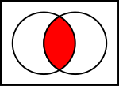
Categories are the base of semantic Web and are called (i) domains (in databases), (ii) types (in Artificial intelligence), (iii) classes (in object oriented programming), and (iv) concepts(in logic). Sets can show Categories. For instance, subclasses can be shown with:
Chapter 1
A Semantic Web Primer

Slide 11
So far we have mainly focused on the techniques that are essential to Semantic Web.
Clearly the introduction of such array of techniques raise a methodological question:
How can tools and techniques best be applied?
Chapter 1
A Semantic Web Primer

Slide 12
Lecture Outline
Introduction
Constructing Ontologies Manually
Reusing Existing Ontologies
Semiautomatic Ontology Acquisition
Ontology Mapping
On-To-Knowledge SW Architecture
Chapter 7
A Semantic Web Primer

Slide 13
In Web Semantic, Ontology is a key factor. Logic has no vocabulary. Ontology fills such a gap, and there are 8 main Stages in Ontology Development:
Determine scope
Consider reuse
Enumerate terms
Define taxonomy
Define properties
Define facets (cardinality, symmetry, transitivity,…………)
Define instances
Check for anomalies
Not a linear process!
Chapter 7
A Semantic Web Primer

Slide 14
Lecture Outline
Introduction
Constructing Ontologies Manually
Reusing Existing Ontologies
Semiautomatic Ontology Acquisition
Ontology Mapping
On-To-Knowledge SW Architecture
Chapter 7
A Semantic Web Primer

Slide 15
Existing Domain-Specific Ontologies
There are many domains for ontology, for instance:
Medical domain: Cancer ontology from the National Cancer Institute in the United States
Cultural domain:
  Art and Architecture Thesaurus (AAT) with 125,000 terms in the cultural domain
  Union List of Artist Names (ULAN), with 220,000 entries on artists
  Iconclass vocabulary of 28,000 terms for describing cultural images
Geographical domain: Getty Thesaurus of Geographic Names (TGN), containing over 1 million entries
Chapter 7
A Semantic Web Primer

Slide 16
Integrated Vocabularies
Merge independently developed vocabularies into a single large resource
E.g. Unified Medical Language System integrating 100 biomedical vocabularies
  The UMLS metathesaurus contains 750,000 concepts, with over 10 million links between them
The semantics of a resource that integrates many independently developed vocabularies is rather low
  But very useful in many applications as starting point
Chapter 7
A Semantic Web Primer

Slide 17
Upper-Level Ontologies
Some attempts have been made to define generally applicable ontologies
  Mot domain-specific
Cyc, with 60,000 assertions on 6,000 concepts
Standard Upperlevel Ontology (SUO)
Chapter 7
A Semantic Web Primer

Slide 18
Topic Hierarchies
Some “ontologies” do not deserve this name:
  simply sets of terms, loosely organized in a hierarchy
This hierarchy is typically not a strict taxonomy but rather mixes different specialization relations (e.g. is-a, part-of, contained-in)
Such resources often very useful as starting point
Example: Open Directory hierarchy, containing more than 400,000 hierarchically organized categories and available in RDF format
Chapter 7
A Semantic Web Primer

Slide 19
Linguistic Resources
Some resources were originally built not as abstractions of a particular domain, but rather as linguistic resources
These have been shown to be useful as starting places for ontology development
  E.g. WordNet, with over 90,000 word senses
Chapter 7
A Semantic Web Primer

Slide 20
Ontology Libraries
Attempts are currently underway to construct online libraries of online ontologies
  Rarely existing ontologies can be reused without changes
  Existing concepts and properties must be refined using rdfs:subClassOf and rdfs:subPropertyOf
  Alternative names must be introduced which are better suited to the particular domain using owl:equivalentClass and owl:equivalentProperty
  We can exploit the fact that RDF and OWL allow private refinements of classes defined in other ontologies
Chapter 7
A Semantic Web Primer

Slide 21
Lecture Outline
Introduction
Constructing Ontologies Manually
Reusing Existing Ontologies
Semiautomatic Ontology Acquisition
Ontology Mapping
On-To-Knowledge SW Architecture
Chapter 7
A Semantic Web Primer

Slide 22
The Knowledge Acquisition Bottleneck
Manual ontology acquisition remains a time-consuming, expensive, highly skilled, and sometimes cumbersome task
Machine Learning techniques may be used to alleviate
  knowledge acquisition or extraction
  knowledge revision or maintenance
Chapter 7
A Semantic Web Primer

Slide 23
Tasks Supported by Machine Learning :
Extraction of ontologies from existing data on the Web
Extraction of relational data and metadata from existing data on the Web
Merging and mapping ontologies by analyzing extensions of concepts
Maintaining ontologies by analyzing instance data
Chapter 7
A Semantic Web Primer

Slide 24
Useful Machine Learning Techniques for Ontology Engineering:
Clustering
Incremental ontology updating
Support for the knowledge engineering
Improving large natural language ontologies
ontology learning
Chapter 7
A Semantic Web Primer

Slide 25
Lecture Outline
Introduction
Constructing Ontologies Manually
Reusing Existing Ontologies
Semiautomatic Ontology Acquisition
Ontology Mapping
Architecture
Chapter 7
A Semantic Web Primer

Slide 26
Ontology Mapping
A single ontology will rarely fulfill the needs of a particular application; multiple ontologies will have to be combined
This raises the problem of ontology integration (also called ontology mapping)
Current major approaches in ontology mapping are:
(i) linguistic,
(ii) statistical,
(iii) structural, and
(iv) logical methods
Chapter 7
A Semantic Web Primer

Slide 27
Four important methods used in ontology mapping are:
(i) linguistic,
(ii) statistical,
(iii) structural, and
(iv) logical methods
Each of these four important methods will be discussed in detail in the next slides:
Chapter 1
A Semantic Web Primer

Slide 28
(i) Linguistic methods
The most basic methods try to exploit the linguistic labels attached to the concepts in source and target ontology in order to discover potential matches
Chapter 7
A Semantic Web Primer

Slide 29
(ii) Statistical Methods
A significant statistical correlation between the instances of a source concept and a target concept, gives us reason to believe that these concepts are strongly related
These approaches rely on the availability of a sufficiently large amount of instances that are classified in both the source and the target ontologies
Chapter 7
A Semantic Web Primer

Slide 30
(iii) Structural Methods
Since ontologies have internal structure, it makes sense to exploit the graph structure of the source and the target ontologies and try to determine similarities, often in coordination with other methods
  If a source target and a target concept have similar linguistic labels, then the dissimilarity of their graph neighborhoods could be used to detect homonym problems where purely linguistic methods would falsely declare a potential mapping
Chapter 7
A Semantic Web Primer

Slide 31
(iv) Logical Methods
The most specific to mapping ontologies
A serious limitation of this approach is that many practical ontologies are semantically rather lightweight and thus don’t carry much logical formalism with them
In any case, if an ontology carries heavy logical formalism, logical methods can be effectively used for its mapping.
Chapter 7
A Semantic Web Primer

Slide 32
Ontology-Mapping Techniques Conclusion
Although there is much potential, and indeed need, for these techniques to be deployed for Semantic Web engineering, this is far from a well-understood area
For Ontology-Mapping , no off-the-shelf techniques are currently available, and it is not clear that this is likely to change in the near future.
Chapter 7
A Semantic Web Primer

Slide 33
Lecture Outline
Introduction
Constructing Ontologies Manually
Reusing Existing Ontologies
Semiautomatic Ontology Acquisition
Ontology Mapping
Architecture
Chapter 7
A Semantic Web Primer

Slide 34
Architecture
Building the Semantic Web or in fact its architecture involves :
  Knowledge Acquisition
  Knowledge Storage
  Query Languages, and
  Knowledge Maintenance
Chapter 7
A Semantic Web Primer

Slide 35
Knowledge Acquisition
Initially, tools must exist that use surface analysis techniques to obtain content from documents
  Unstructured natural language documents: statistical techniques and shallow natural language technology
  Structured and semi-structured documents: wrappers induction, pattern recognition
Chapter 7
A Semantic Web Primer

Slide 36
Knowledge Storage
The output of the analysis tools is sets of concepts, organized in a shallow concept hierarchy with at best very few cross-taxonomical relationships
RDF/RDF Schema are sufficiently expressive to represent the extracted info
  Store the knowledge produced by the extraction tools
  Retrieve this knowledge, preferably using a structured query language
Chapter 7
A Semantic Web Primer

Slide 37
Some Exercises on SPARQL and starting to learn about logic
(completed next week)
Chapter 1
A Semantic Web Primer

Slide 38
Specifically, the following query returns names and emails of every person in the dataset:
PREFIX foaf: <http://xmlns.com/foaf/0.1/>
SELECT ?name
?email
WHERE
{
?person a foaf:Person .
?person foaf:name ?name .
?person foaf:mbox ?email .
}
Source: https://en.wikipedia.org/wiki/SPARQL
Chapter 1
A Semantic Web Primer

Slide 39
Another SPARQL query example that models the question "What are all the country capitals in Africa?":
PREFIX ex: <http://example.com/exampleOntology#>
SELECT ?capital
?country
WHERE
{
?x ex:cityname ?capital ;
ex:isCapitalOf ?y .
?y ex:countryname ?country ;
ex:isInContinent ex:Africa .
}
Source: https://en.wikipedia.org/wiki/SPARQL
Chapter 1
A Semantic Web Primer

Slide 40
Intersection of Horn Logic and OWL is called DLP (Description Logic Program).
Chapter 1
A Semantic Web Primer

Slide 41
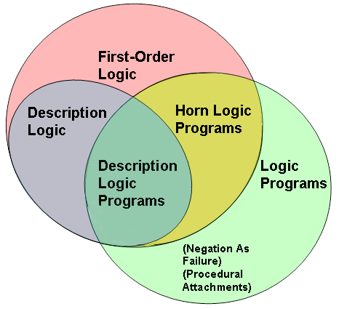
the relation of OWL Description Logic Program (DLP) to other languages:
Note that here by logic program we mean a finite set of facts and rules and not a computer program.
In this lecture we describe this relation in detail:
Chapter 4
A Semantic Web Primer

Slide 42
Equivalent terms:
In OWL: in Description Logic:
class = concept
property = role
Object = individual
Chapter 1
A Semantic Web Primer

Slide 43
In Description logic Program (DLP) we can use:
intersection or conjunction of concepts C and D
union or disjunction of concepts C or
negation or complement of concepts not
universal restriction in C
existential restriction in C
Chapter 1
A Semantic Web Primer

Slide 44
Conventional Notation
Description Read
intersection or conjunction of concepts C and D
union or disjunction of concepts C or D
negation or complement of concepts (¬) not C
universal restriction (∀) all R-successors are in C
existential restriction (∃) an R-successor exists in C
Concept inclusion all C are D
Concept equivalence C is equivalent to D
Concept definition C is defined to be equal to D
Concept assertion a is a C
Role assertion a is R-related to b
Source : http://en.wikipedia.org/wiki/Description_logic
Chapter 1
A Semantic Web Primer

Slide 45
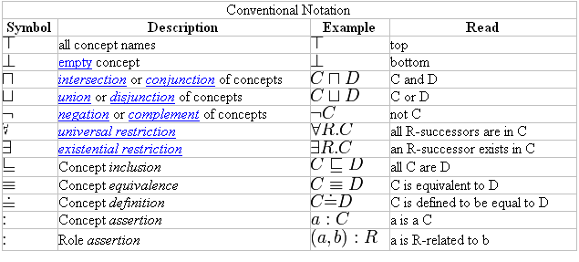
Source : http://en.wikipedia.org/wiki/Description_logic
Chapter 1
A Semantic Web Primer

Slide 46
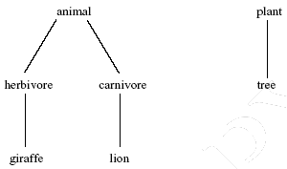
Expand African Wildlife Ontology –
Class Hierarchy in whatever fashion you like and express it in Description Logic
Chapter 1
A Semantic Web Primer

Slide 47
Knowledge Representation
The subjects presented so far were related to the representation of knowledge
Knowledge Representation was studied long before the emergence of WWW in AI
Logic is still the foundation of KR, particularly in the form of predicate logic (first-order logic)
Chapter 5
A Semantic Web Primer

Slide 48
Three Exercises
Chapter 1
A Semantic Web Primer

Slide 49
Exercise 1: Express the following as facts, rules, and questions
“clyde” is a Tiger
“simi” is a rabbit
Rabbits hate tigers
Rabbit is a Species
Tiger is a Species
***********************
Is “clyde” a Species?
Does “simi” like “clyde”?
Chapter 1
A Semantic Web Primer

Slide 50
Answer:
Facts:
Tiger(clyde)
Rabbit(simi)
Rules:
Hate(X,Y) → ¬ Like (X,Y)
Rabbit(X), Tiger(Y) → Hate(X,Y)
Rabbit(X) → Species(X)
Tiger(X) → Species(X)
Questions:
→ Species(clyde)
→Like(simi,clyde)
Chapter 1
A Semantic Web Primer

Slide 51
Consider the following facts in a database about family relationships:
  mother(X,Y), X is the mother of Y
  father(X,Y), X is the father of Y
  uncle(X,Y), X is the uncle of Y
  brother(X,Y), X is the brother of Y
  sister(X,Y), X is the sister of Y
  notSame(X,Y), X is not the same as Y
  male(X), X is male
  female(X), X is female
Chapter 1
A Semantic Web Primer

Slide 52
Exercise 2:
a) Express a rule showing
X is the grandmother of y
b) Express a pair of rules showing X is a half-sister of Y
Chapter 1
A Semantic Web Primer

Slide 53
Answer:
a)
mother(X,P), parent(P,Y) → grandmother(X,Y)
b)
female(X),mother(M,X), mother(M,Y), father(F1,X), father(F2,Y), notSame (F1,F2)→ half-sister(X,Y)
female(X), father(F,X), father(F,Y)mother(M1,X), mother(M2,Y), notSame (M1,M2)→
half-sister(X,Y)
Chapter 1
A Semantic Web Primer

Slide 54
Exercise 3: Name the three types of container elements in RDF and provide an example for each of them.
Chapter 1
A Semantic Web Primer

Slide 55
Answer:
Three Types of Container Elements
1) rdf:Bag an unordered container, allowing multiple occurrences
  For example, members of the faculty board, documents in a folder
2) rdf:Seq an ordered container, which may contain multiple occurrences
  For example, modules of a course, items on an agenda, an alphabetized list of staff members (order is imposed)
3) rdf:Alt a set of alternatives
  For example, translations of a document in various languages
Chapter 1
A Semantic Web Primer

Slide 56
Bag in RDF:
<uni:lecturer rdf:ID="949352" uni:name="Grigoris Antoniou“ uni:title="Professor">
<uni:coursesTaught>
<rdf:Bag>
<rdf:_1 rdf:resource="#CIT1112"/>
<rdf:_2 rdf:resource="#CIT3116"/>
</rdf:Bag>
</uni:coursesTaught>
</uni:lecturer>
Chapter 1
A Semantic Web Primer

Slide 57
Alt in RDF:
<uni:course rdf:ID="CIT1111"
uni:courseName="DiscreteMathematics">
<uni:lecturer>
<rdf:Alt>
<rdf:li rdf:resource="#949352"/>
<rdf:li rdf:resource="#949318"/>
</rdf:Alt>
</uni:lecturer>
</uni:course>
Chapter 1
A Semantic Web Primer

